Slide 1
Virginia Opioid Addiction ECHO* Clinic
December 2, 2022
*ECHO: Extension of Community Healthcare Outcomes

Slide 2
Helpful Reminders
Rename
Rename your Zoom screen, with your name and organization

Slide 3
Helpful Reminders
You are all on mute
please unmute to talk
If joining by telephone audio only, *6 to mute and unmute
Unmute

Slide 4
Helpful Reminders
Please type your full name and organization into the chat box
Use the chat function to speak with IT or ask questions
Chat Box

Slide 5
VCU Opioid Addiction ECHO Clinics
Bi-Weekly 1 hour teleECHO Clinics
Every teleECHO clinic includes a 30 minute didactic presentation followed by case discussions
Didactic presentations are developed and delivered by interprofessional experts
Website Link: www.vcuhealth.org/echo

Slide 6
Hub and Participant Introductions
VCU Team
Clinical Director | F. Gerard Moeller, MD
Administrative Medical Director ECHO Hub | F. Gerard Moeller, MD
Clinical Experts Didactic Presentation Subject Matter Expert Program Manager Senior Program Coordinator | Lori Keyser-Marcus, PhD Courtney Holmes, PhD Albert Arias, MD Megan Lemay, MD F. Gerard Moeller, MD F. Gerard Moeller, MD Leslie Bobb, MPH Lillie Lattimore, MA
Name
Organization
Reminder: Mute and Unmute screen to talk
*6 for phone audio
Use chat function for Introduction

Slide 7
What to Expect
Didactic Presentation
F. Gerard Moeller, MD
Case presentations
Case 1
Case summary
Clarifying questions
Recommendations
Closing and questions
Lets get started!
Didactic Presentation

Slide 8
Disclosures
Gerry Moeller, MD has no financial conflicts of interest to disclose.
There is no commercial or in-kind support for this activity.

Slide 9
Overdose Risk for Patients Coming out of Controlled Environments
F. Gerard Moeller, M.D.
Professor and Division Chair: Addictions
Department of Psychiatry
VCU School of Medicine
Director, VCU Wright Center for Clinical and Translational Research

Slide 10
Disclosures
Past grant funding: Indivior pharmaceuticals
Consulting: Boehringer Ingelheim, AstraZeneca

Slide 11
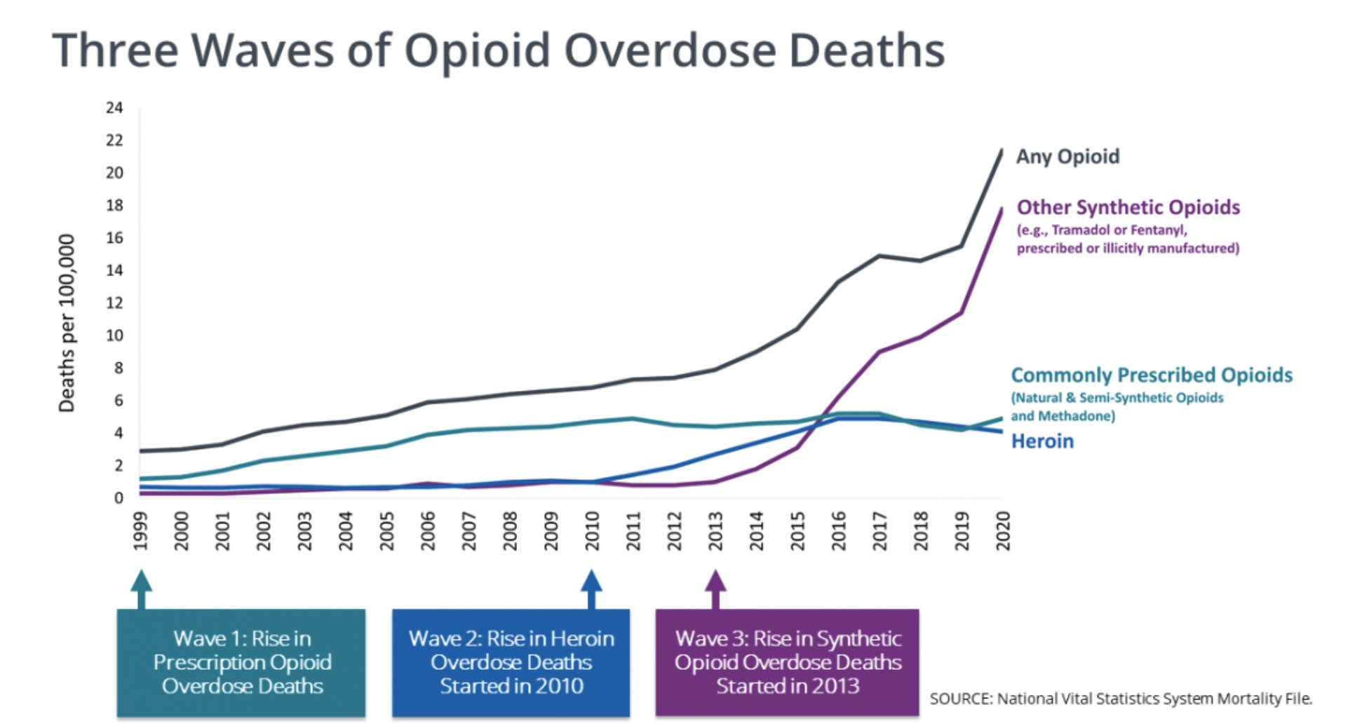
Where we are
The US opioid epidemic has reached an alarming scale, with more than 100,000 drug overdose deaths occurring across the US in 2021, and most of these deaths due to opioids (CDC).

Slide 12
Overdose Deaths in Virginia Mirror US Data
Overdose Became #1 Cause of Unnatural Death in 2013
Highest Ever in 2021, Maybe Slightly better this year

Slide 13
How do we Get Out of This?
Simply Reducing Opioid Prescriptions
Is not enough
JAMA 2022 Overdose Epidemic Report

Slide 14
Engaging High Risk Patients: Where is the Risk Greatest?
Medication treatment utilizing methadone, buprenorphine, or naltrexone in addition to behavioral interventions has proven to be effective at reducing all-cause mortality and overdose deaths in patients with opioid use disorder (Ma, Bao et al. 2018).
Where would these interventions have the highest impact?
Two high risk groups that could be engaged:
Patients who survive an Overdose
Approximately 1,000,000 non-fatal overdoses are treated in US emergency departments annually (1)
Non-fatal overdoses have significant risk of death after discharge
Individuals recently released from a controlled environment
(1) Vivolo-Kantor et al., 2020

Slide 15
Risk of Death after Release
Binswanger et al., NEJM 2007
Retrospective study of inmates released from Washington State prisons 1999-2003
30,237 released inmates
443 deaths (3.5 times death rate for state)
A leading cause of death was drug overdose

Slide 16
Individuals Recently Released from Incarceration are at Higher Risk of Overdose
Incarcerated individuals report a high rate of opioid misuse prior to incarceration
20% of state prisoners and 11% of Federal prisoners ever used heroin
5% of state prisoners were using heroin at the time of the offense ¹
Reduced access to opioids leads to loss of tolerance
Medications for OUD are underutilized in jails/prisons ²
(1. Maruschak et al., 2021
2. Komalasari et al., 2021)

Slide 17
Fentanyl Increases Risks

Slide 18
Fentanyl
Perfect storm increasing risk of overdose in individuals coming out of controlled environment
Loss of tolerance PLUS higher potency drugs in community
Synthetic opioid
Often contaminant in other illicit drugs
50 times more potent than heroin
100 times more potent than morphine

Slide 19
More Recent North Carolina data Confirms Increased Deaths
From Anapurwalla et al., 2018

Slide 20
Overdose after Incarceration in the US
Mital et al., 2020. Review of 18 studies published after 2001. Conclusions:
“Upon release from incarceration, individuals are at heightened risk of drug OD.”
“Interventions with a strong evidence base, such as low-barrier MOUD provision to persons with opioid use disorder in correctional settings, effective linkage-to-care programs upon release, and provision of Opioid Education and naloxone distribution to currently and formerly incarcerated individuals, can protect against OD in this highly vulnerable population.”

Slide 21
Barriers to MOUD in Incarcerated Individuals
Reasons for lack of medication use in jails/prisons
Lack of prescribing providers
Concern over diversion of buprenorphine
Inconsistent bridging to care after incarceration
Historical prejudice against agonist/partial agonist treatments
Funding

Slide 22
National Academy for
State Health Policy NASHP.org

Slide 23
Medications for OUD are Effective in Prison/Jail populations
Green et al., JAMA Psychiatry 2018
Screening and protocoled treatment with MOUD (including methadone, buprenorphine, or naltrexone) launched at the Rhode Island Department of Corrections
All sites were operational by January 2017.
Individuals arriving into incarceration while receiving MOUD were maintained on medications without tapering or discontinuing.
Community-located Centers of Excellence were established to promote transitions and referrals of inmates released from incarceration.

Slide 24
Medications for OUD are Effective in Prison/Jail populations
Green et al., JAMA Psychiatry 2018 Results
Retrospective cohort analysis of statewide program January to June 2016 compared to January to June 2017
State medical examiner data of individuals who were incarcerated who died from an OD within 12 months of release
Results showed a reduction from 179 to 157 ODs.
12.3% reduction in overdose deaths within 12 months of release from prison after medication treatment program launched

Slide 25
Medications for OUD are Effective in Prison/Jail populations
Caveats
Challenges in getting accurate data post discharge
Randomized studies difficult carry out in prisons
Relapse rates are high post release (Woody et al., 2021, Gordon et al., 2017 Drug and Alcohol Dependence)

Slide 26
Incarcerated Individuals Opinions on Treatment
Treitler et al., 2022 Substance Abuse
Survey of 53 recently incarcerated individuals (62.3% in MOUD during and after incarceration)
Majority reason for MOUD: Achieving recovery and reducing opioid use
Prior medication use and fear of side effects drove choice of specific MOUD (buprenorphine vs. depot naltrexone)

Slide 27
Important Points to Consider
Greatest risk is immediately after release from controlled environment
Bridging with pharmacotherapy is critical
Maryland Department of Health
and Mental Hygiene

Slide 28
Bridging from Controlled Environment
Barriers
Unanticipated timing of release
Change in health insurance after release
Lack of providers prior to release
Difficulty referring inmates to outpatient care
Facilitators
Reentry planning
Community partners
Care coordination
Bridge scripts/depot formulations
Use of navigators
Matsumoto et al., 2022

Slide 29
Telehealth as a Potential Bridge to Care VCU Addiction Bridge Clinic
Provide next-day follow-up for pts. after ED visit
Simple and fast ED referral process
Provide effective, patient-centered care
Utilize a telehealth platform

Slide 30
VCU Virtual Addiction Bridge Clinic (ABC)
Refer
ED order in EHR (Epic)
Referral card
Bridge
Coordinator engages pt.
Clinical ABC visit takes place within 24 hours of ED visit
Cross
Cross bridge to in-person visit
Longitudinal addiction care
Process:

Slide 31
VCU Virtual Addiction Bridge Clinic (ABC)
Preliminary results with comparison group
Patient Group:
201 Patients seen in ED with opioid related diagnosis between March and December 2021 referred to ABC
Control Group:
271 Patients seen in ED with opioid related diagnosis during the same time period but received “standard” referral to outpatient treatment

Slide 32
VCU Virtual Addiction Bridge Clinic (ABC)
Results with comparison group
Group (n) | Seen by Virtual Provider in Bridge Clinic | Seen Face to Face in Outpatient Clinic
ABC (201) | 42% | 31.3%
Comparison (271) | 0% | 3.3%

Slide 33
VCU Virtual Addiction Bridge Clinic (ABC)
Strengths/Challenges
Approximately 40% referred to ABC complete telehealth appointment, with 74% of those patients making it to face to face outpatient treatment
36% were non-fatal overdoses, many patients did not come to ED for OUD treatment
Logistic challenges: getting providers to make ABC referral, accurate phone number, unreliable phone service, homelessness

Slide 34
Summary
Individuals with OUD being released from controlled environment are at high risk of overdose
Medication for Opioid Use disorder reduces risk of overdose and death
Coordinated care pre and post release is needed
Telehealth may be a useful platform to bridge to outpatient care

Slide 35
Questions?

Slide 36
Case Presentation #1 Kathleen DiPasquale Seelig, MD Nickel Bridge Family Medicine
12:35-12:55 [20 min]
5 min: Presentation
2 min: Clarifying questions- Spokes
2 min: Clarifying questions – Hub
2 min: Recommendations – Spokes
2 min: Recommendations – Hub
5 min: Summary - Hub
Reminder: Mute and Unmute to talk
*6 for phone audio
Use chat function for questions

Slide 37
Main Question
Since my prior presentation I have gained confidence in diagnosing and initiating treatment for adult ADHD. My case today revolves around creating a stable, respectful and effective prescribing environment for adults with ADHD.
Demographics
27 year old Black man, married, lives with wife and 2 young daughters. Mother is source of support. Has 7 year old with previous partner
Reminder: Mute and Unmute to talk
*6 for phone audio
Use chat function for questions

Slide 38
Medical, Behavioral, Mental Health History
Diagnosed at age 13 with ADHD, started medication at that time. Seen at RBHA initially. Reports difficulty establishing and maintaining a therapeutic relationship with a psychiatric prescriber. States his last stable psychiatry relationship was about 4 years ago, seeing Dr David Gould at Tuckers. Dismissed from practice due to being percieved as threatening to front office staff when asking for a refill.
Seen a practice in Emporia for about a year, but was unable to make the hour long drive every four weeks. Recently transitioned to Good Neighbor Psychiatry care, but has struggled with communication with office.
Recently diagnosed as bipolar, has also had diagnosis of depression and anxiety. States Wellbutrin added recently but feels it has not been helpful.
Presented to me stating he had been out of medication for 4 days, and requesting refill on Adderall and Xanax
Reminder: Mute and Unmute to talk
*6 for phone audio
Use chat function for questions

Slide 39
Past Interventions
Patient presented with symptoms of unmanaged ADHD. I attempted to refill his medication, but then found from pharmacy that he had picked up a 30 day supply of medication the week prior.
Future Plans, Patient’s Treatment Goals
Patient returned for his follow up visit. We discussed how my office can support him in navigating the healthcare system, and can be a consistent hub should he need to change psych providers. I called his current psychNP, and confirmed that my refill was a one off, and would not disrupt his controlled substance agreement there.
This is a patient who struggles to meet the level of compliance needed to get a regular supply of medication. He justifiably lacks confidence in the delivery system of psychiatric care in which he finds himself, but his actions (requesting an early refill from a new provider) raise the kind of red flags that make it even harder for him to get his medication.
Reminder: Mute and Unmute to talk
*6 for phone audio
Use chat function for questions

Slide 40
Case Studies
Case studies
Submit: www.vcuhealth.org/echo
Receive feedback from participants and content experts
Earn $100 for presenting

Slide 41
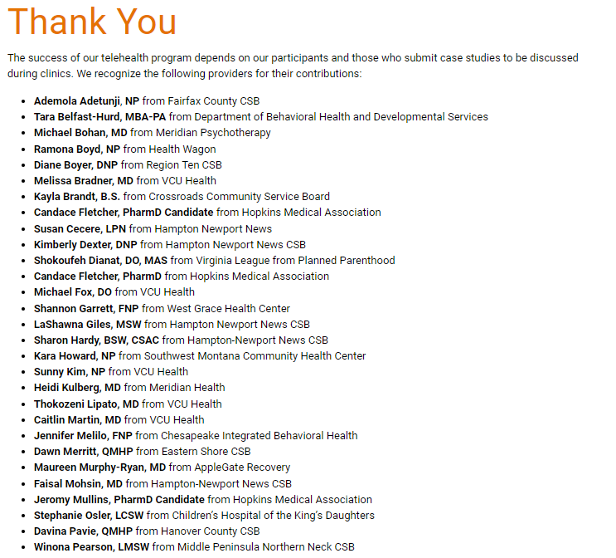
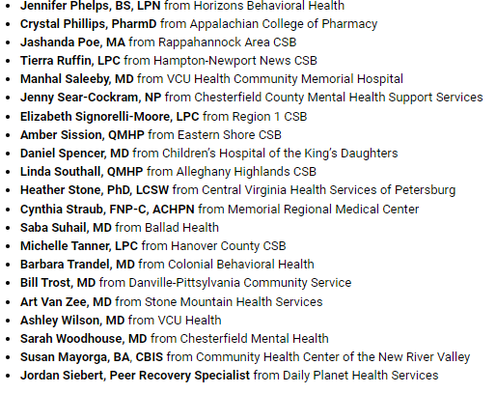
Dana DeHart, from Piedmont CSB
Kathleen DiPasquale Seelig, from Nickel Bridge Family Medicine

Slide 42
Claim Your CME and Provide Feedback
www.vcuhealth.org/echo
To claim CME credit for today's session
Feedback
Overall feedback related to session content and flow?
Ideas for guest speakers?

Slide 43
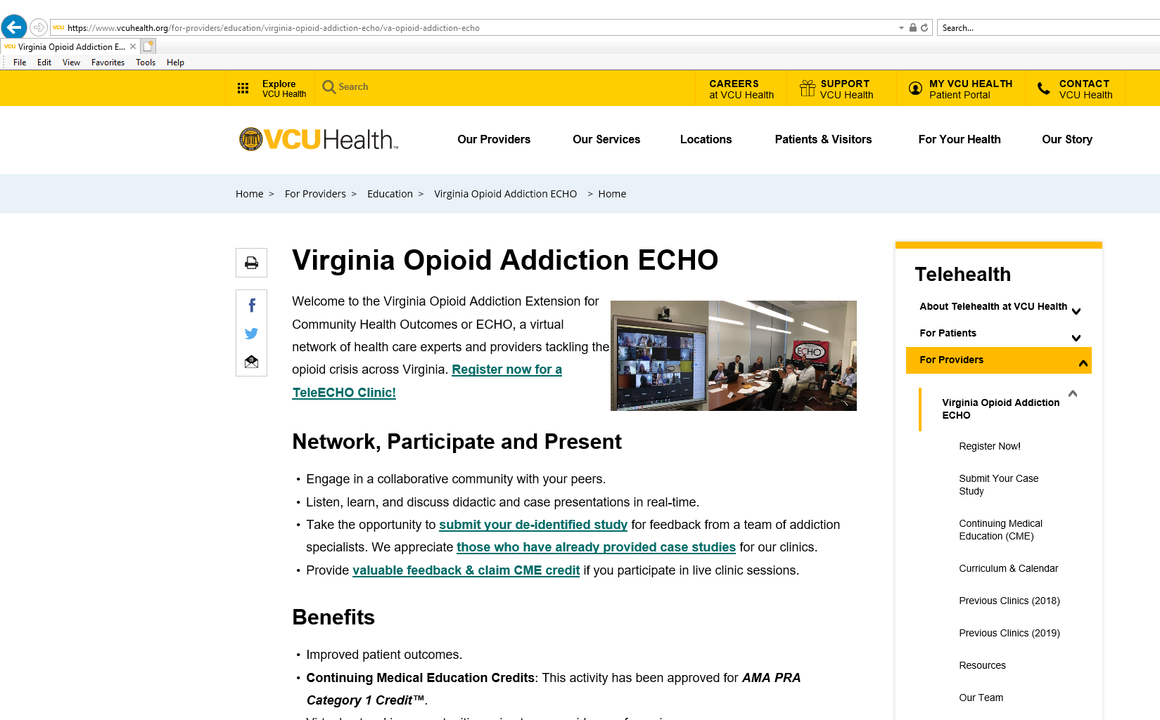
Access Your Evaluation and Claim Your CME

Slide 44
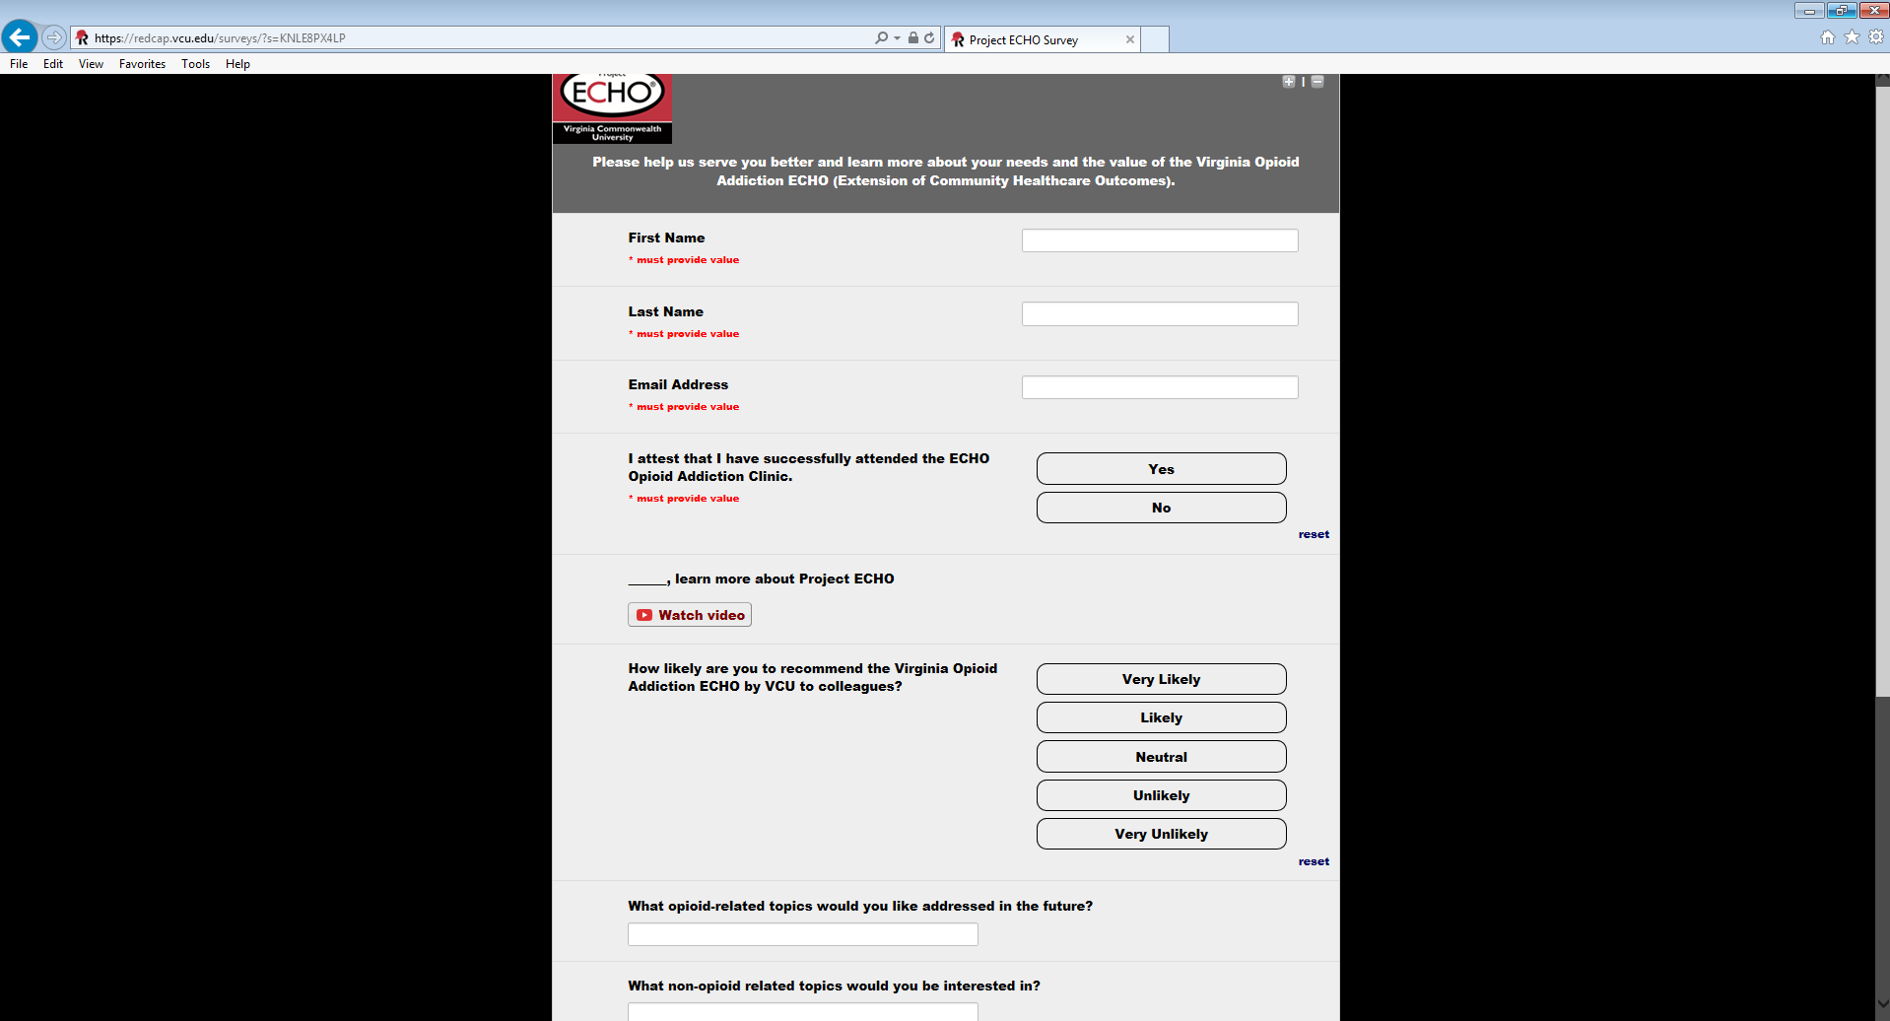
Access Your Evaluation and Claim Your CME

Slide 45
Access Your Evaluation and Claim Your CME
www.vcuhealth.org/echo
To view previously recorded clinics and claim credit

Slide 46
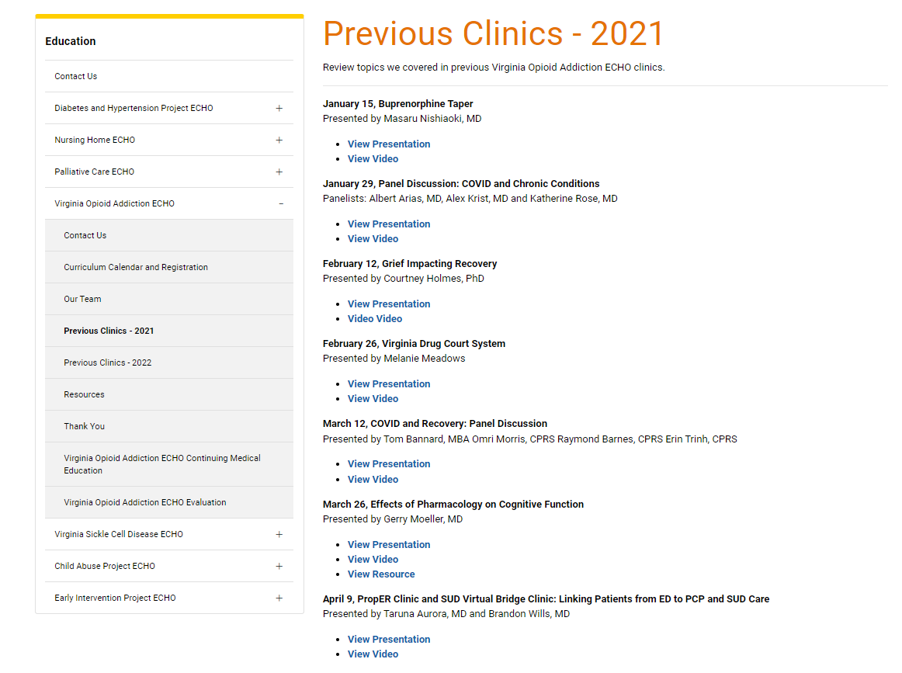
Access Your Evaluation and Claim Your CME

Slide 47
VCU Virginia Opioid Addiction TeleECHO Clinics Bi-Weekly Fridays - 12:00-1:00 pm
Mark Your Calendar --- Upcoming Sessions
Dec. 16: Communication with Patients on Risk of Overdose- Lori Keyser Marcus, PhD
Jan. 13: Appreciative Inquiry and Brainstorming Session – Group Discussions
Please refer and register at vcuhealth.org/echo

Slide 48
THANK YOU!
Reminder: Mute and Unmute to talk
*6 for phone audio
Use chat function for questions

