Slide 1

Virginia Sickle Cell Disease ECHO* Clinic
March 6th, 2019
*ECHO: Extension of Community Healthcare Outcomes

Slide 2
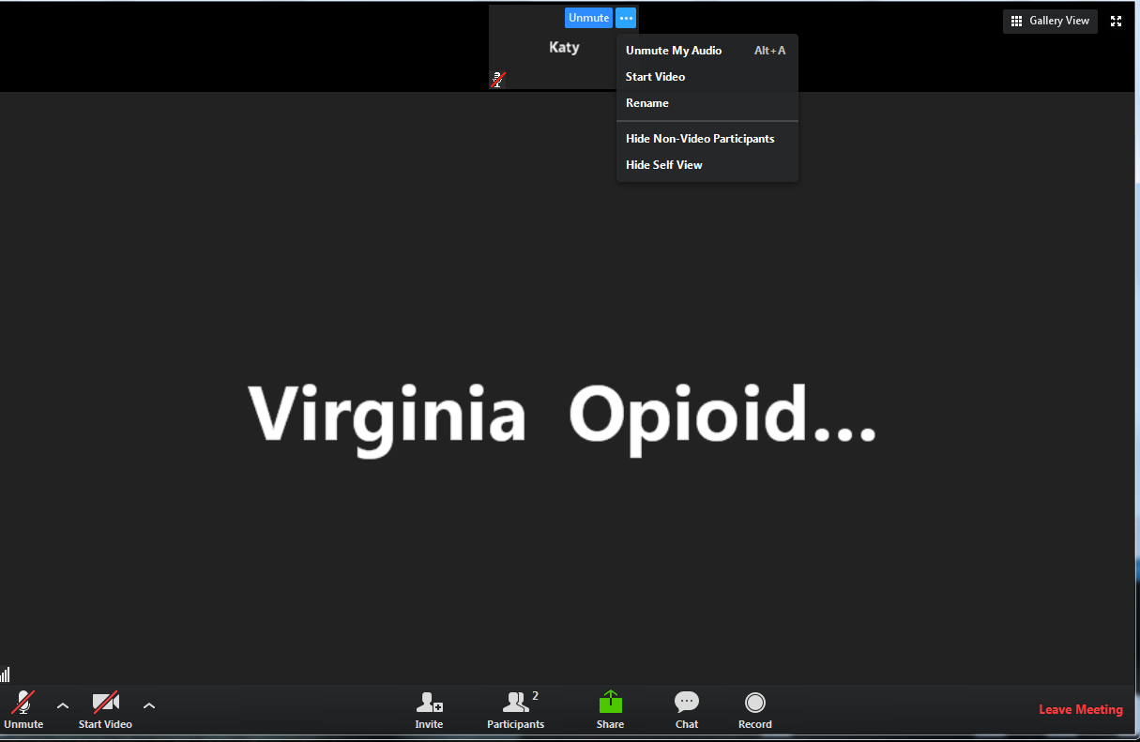

Helpful Reminders
Rename
Rename your Zoom screen, with your name and organization

Slide 3
Helpful Reminders
You are all on mute
please unmute to talk
If joining by telephone audio only, *6 to mute and unmute
Unmute

Slide 4
Helpful Reminders
Please type your full name and organization into the chat box
Use the chat function to speak with IT or ask questions
Chat Box

Slide 5




VCU Sickle Cell Disease ECHO Clinics
Monthly 2 hours tele-ECHO Clinics
Every tele-ECHO clinic includes 2 case presentations and a didactic presentation
Didactic presentations are developed and delivered by inter-professional experts in Sickle Cell Disease care and management
Website Link: http://vcuhealth.org/sicklecellecho

Slide 6
Hub Introductions
VCU Team
Clinical Director | Wally R Smith, MD
Administrative Medical Director ECHO Hub and Principal Investigator | Wally R Smith, MD
Clinical Expert Didactic Presentation Program Manager IT Support Administrative Assistant Clinical Social Worker Patient Navigators Prior Authorization Specialist | India Y Sisler, MD Thokozeni Lipato, MD Jennifer Newlin, PA Mica Ferlis, NP India Sisler, MD Shirley Johnson, LSW Daniel M Sop, M.Sc.Eng Donna Casey Taylor Elliott, MSW Marla Brannon, BSW Stefani Vaughan-Sams Austin Hardy

Slide 7
Spoke/ Participant Introduction
Name
Organization

Slide 8

What to Expect
Case presentation #1 – Benjamin Goodman, MD
    Case summary
    Clarifying questions
    Recommendations
    Recap
Didactic Presentation
  Title: Issues in Sickle Cell Transition
  Presenter: India Y Sisler, MD
Case presentation #2 – Bradley Rolfe, MD
    Case summary
    Clarifying questions
    Recommendations
    Recap
Closing and questions
Lets get started!
Case Presentation #1

Slide 9

Case Presentation #1
12:50PM to 1:15pm [25 min]
  Presentation: (5 min)
  Case summary: Clinical Hub Lead(5 min)
  Clarifying questions- Spokes (participants) 4 min:
  Clarifying questions – Hub (4 min):
  Recommendations – Spokes (participants) 2 min:
  Recommendations – Hub (2 min):
  Recap Case /Recommendations- Hub (3 min):

Slide 11
Didactic Presentation

Slide 12

Transition in Sickle Cell Disease
India Sisler, MD
Director, Pediatric Comprehensive Sickle Cell Program

Slide 13
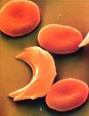
Overview
What is transition?
Why do we care?
Transition models

Slide 14
The Last 100 Years
Newborn screening
Prophylactic penicillin
Effective vaccination against pneumococcal disease and HiB
Hydroxyurea increasing life expectancy
SCT first curative treatment

Slide 15
Life Expectancy
1963
  Sir John Dacie: “Sickle Cell Anemia is essentially a disease of childhood.”
1973
  Average life expectancy was 14.3 years
  20% of patients died in the first 2 years of life
1990s
  Late 30s/Early 40s
    Represents a decrease of 25-30 years from the African American population as a whole
Notes:
We think now in the 50s due to use of HU, may increase even more

Slide 16
Mortality
Survival to adulthood has improved dramatically
However mortality in adults is rising
  The first sharp rise in mortality is around the time of transition

Slide 17
Survival to Adulthood
Dallas Newborn Cohort (DNC)
  Cohort of patients followed prospectively
  Enrollment began in 1983
  University of Texas
  940 patients
Overall survival for patients with homozygous sickle cell disease is 93.9%
SC and sickle beta + 98.4%
Blood 2010;115:3447-3452

Slide 18
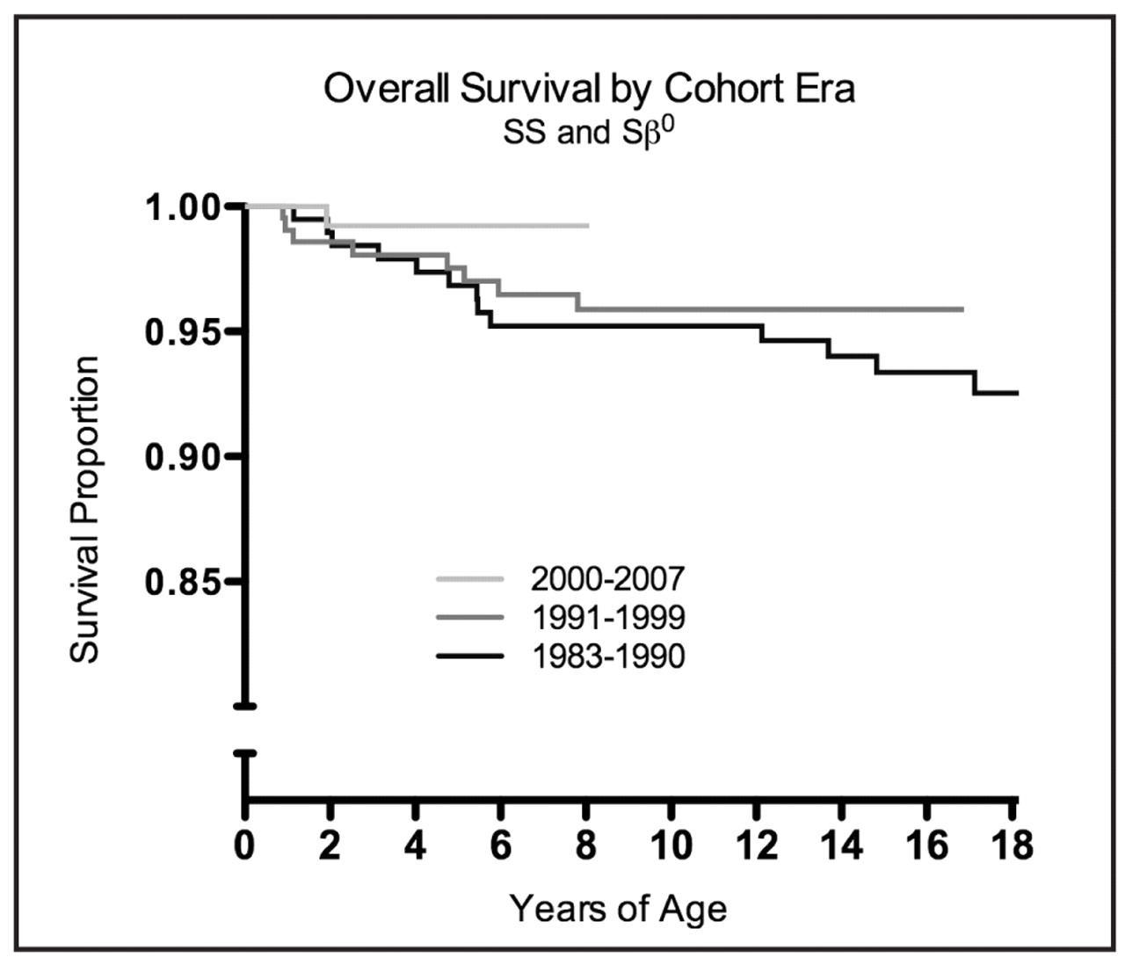
Survival to Adulthood
Blood 2010;115:3447-3452
Notes:
Age to first visit at comprehensive center, age at pcn initiation, age at pneumococcal vaccineation improved over time

Slide 19
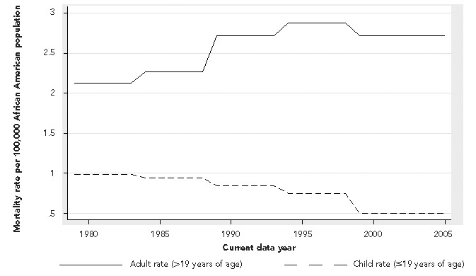
Mortality
Life Expectancy | 2005 | 2013
Males | 38 | 33.4
Females | 42 | 36.9
Lanzkron, Carroll, Haywood. Mortality Rates and Age at Death from Sickle Cell Disease: US, 1979-2005. Public Health Reports. Mar-Apr 2013
Notes:
16,654 sickle cell patients, data from the National Center for Health Stats.

Slide 20
Mortality
Hamideh. Pediatric Blood and Cancer 2013

Slide 21
Adolescents and Young Adults
Growing population
Require comprehensive care
Adolescence and young adulthood is a high risk time
  Medically
  Psycosocially

Slide 22
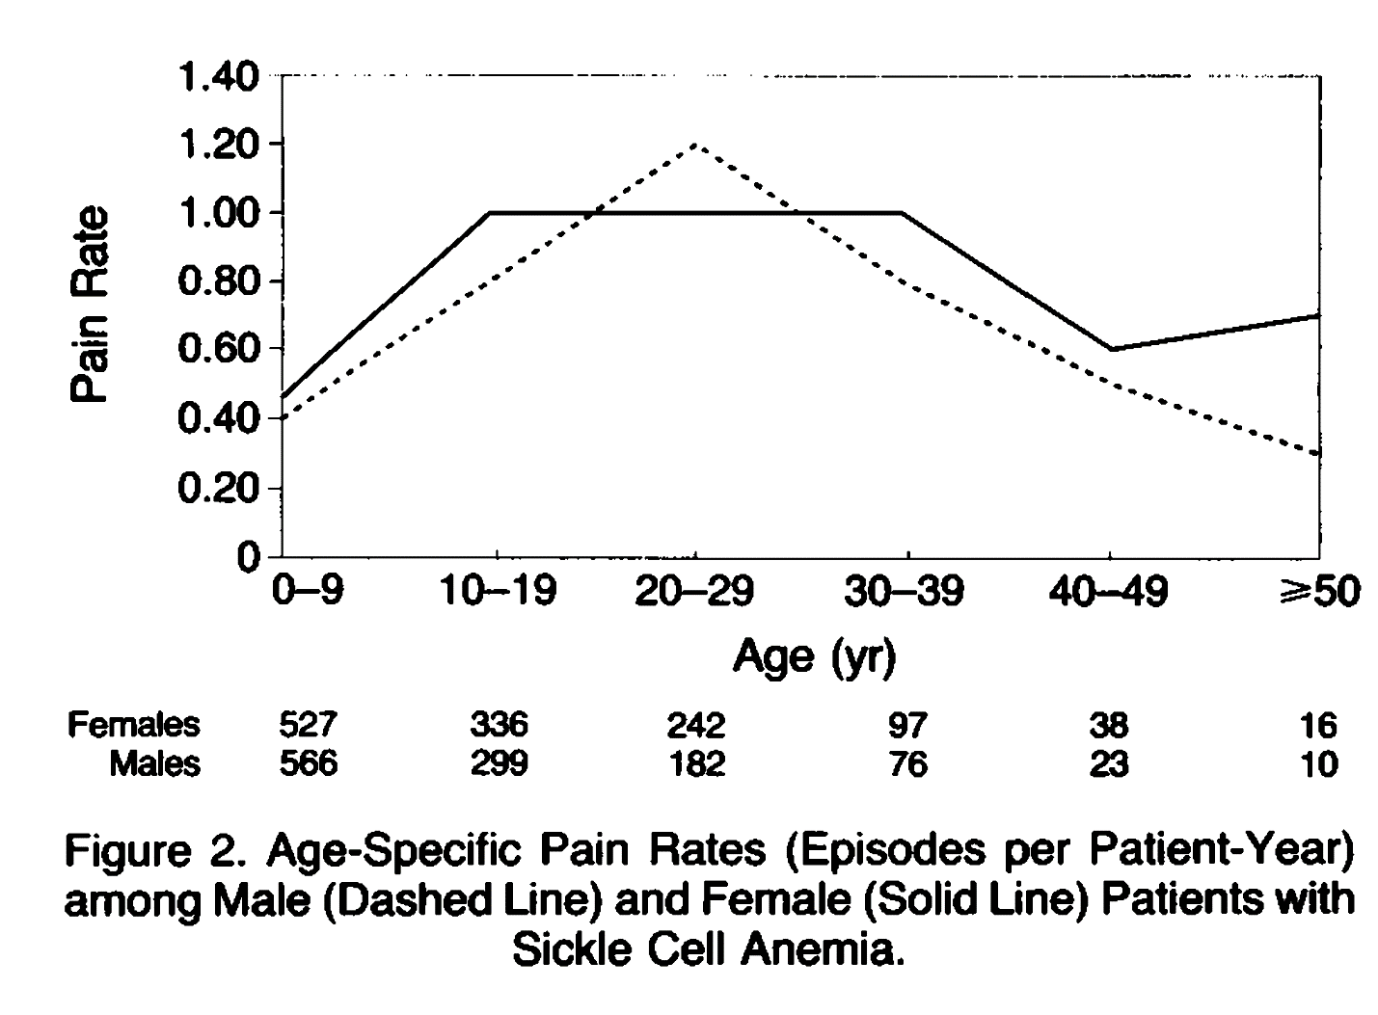
Pain
NEJM 1991;325:11-16.

Slide 23
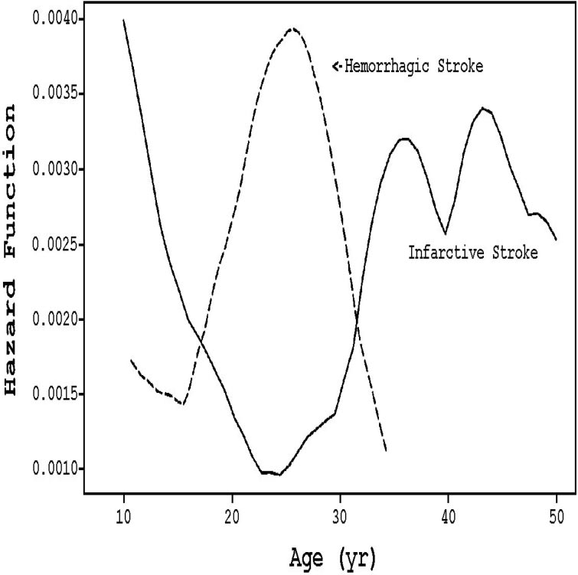
Stroke
Blood 2009;114:5114-25.

Slide 24
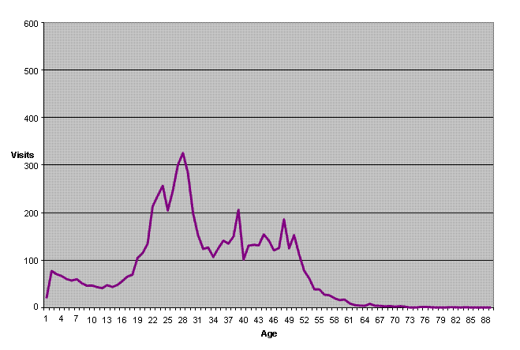
Emergency Room Utilization
Paulukonis et al. ASH 2010
Notes:
RuSH: registry and surveilance system for hemoglobinopathies pilot program
Collecting data to determine how many people have SCD, creating database that can be used for research and develop health promotion and educational materials
Collected from 2005-2008 (over 4 year period of time)

Slide 25
Emergency Room Utilization
Age Group | Percent of Visits Uninsured
10-20 years | 8%
20-30 years | 19%
30-40 years | 17%
Paulukonis et al. ASH 2010

Slide 26
Disease Severity
Shah et al. Pediatric Blood and Cancer. 2019

Slide 27
Disease Severity
Shah et al. Pediatric Blood and Cancer. 2019

Slide 28
What is Transition?
Decision making gradually shifts
**Note- transition does NOT require a new provider! Just a new model of care!
Parent
Adolescent-Parent Unit
Young Adult
Notes:
Historically done at a certain age or some other milestone
Also when patient exhibited “adult behaviors”
Now considered a process with a beginning middle and end

Slide 29
AAP Principles of Transition
1. Importance of youth- and/or young adult–centered, strength based focus
2. Emphasis on self-determination, self-management, and family and/or caregiver engagement
3. Acknowledgment of individual differences and complexities
4. Recognition of vulnerabilities and need for a distinct population health approach for youth and young adults
5. Need for early and ongoing preparation, including the integration into an adult model of care
https://pediatrics.aappublications.org

Slide 30
AAP Principles of Transition
6. Importance of shared accountability, effective communication, and care coordination between pediatric and adult clinicians and systems of care
7. Recognition of the influences of cultural beliefs and attitudes as well as socioeconomic status
8. Emphasis on achieving health equity and elimination of disparities
9. Need for parents and caregivers to support youth and young adults in building knowledge regarding their own health and skills in making health decisions and using health care.
https://pediatrics.aappublications.org

Slide 31
Got Transition?
www.gottransition.org

Slide 32
Got Transition?
www.gottransition.org

Slide 33
Transition at CHoR
Education starts when patients enter high school
Transition Binder
  Medical
  Psychosocial
  Educational/Vocational
  Insurance

Slide 34

Transition at CHoR
2 Retreats Per Year
  Fall Retreat
  Spring Retreat

Slide 35

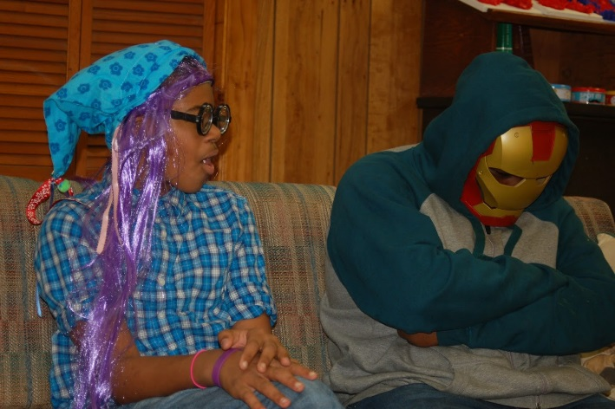
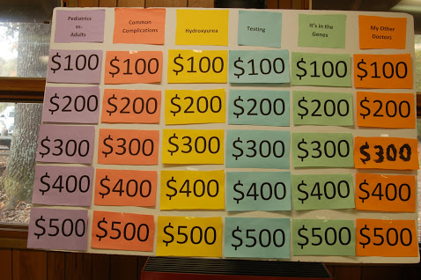
Transition at CHoR

Slide 36
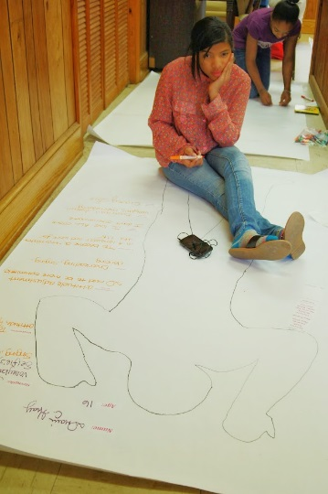



Transition at CHoR

Slide 37
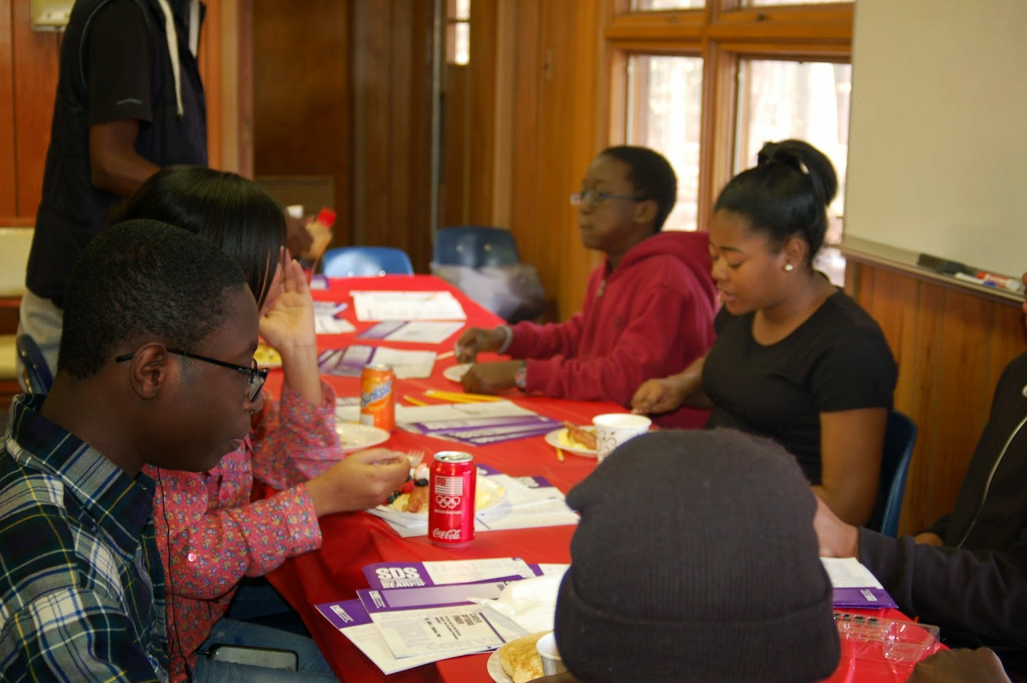



Slide 38
Transition Outcomes
Attends First Visit at Adult Clinic
  Historic Data: 50%
  After initiation of Transition: 89-100%
One year after transition
  60% of patients in care
Two Years after Transition
  30% of patients in care

Slide 39
Transition at VCU
Transition services to continue into the adult clinic environment for patients to age 25 (ish)
  Young Adult Support Group
    High school seniors invited to make early introductions to adult staff
Patient Navigator/SW assigned to every transition patient
Continued access to appropriate pediatric psychosocial services

Slide 40
Case Presentation #2
1:40- 2:00pm [25 min]
  Presentation: (5 min)
  Case summary: Clinical Hub Lead(5 min)
  Clarifying questions- Spokes (participants) 4 min:
  Clarifying questions – Hub (4 min):
  Recommendations – Spokes (participants) 2 min:
  Recommendations – Hub (2 min):
  Recap Case /Recommendations- Hub (3 min):

Slide 42
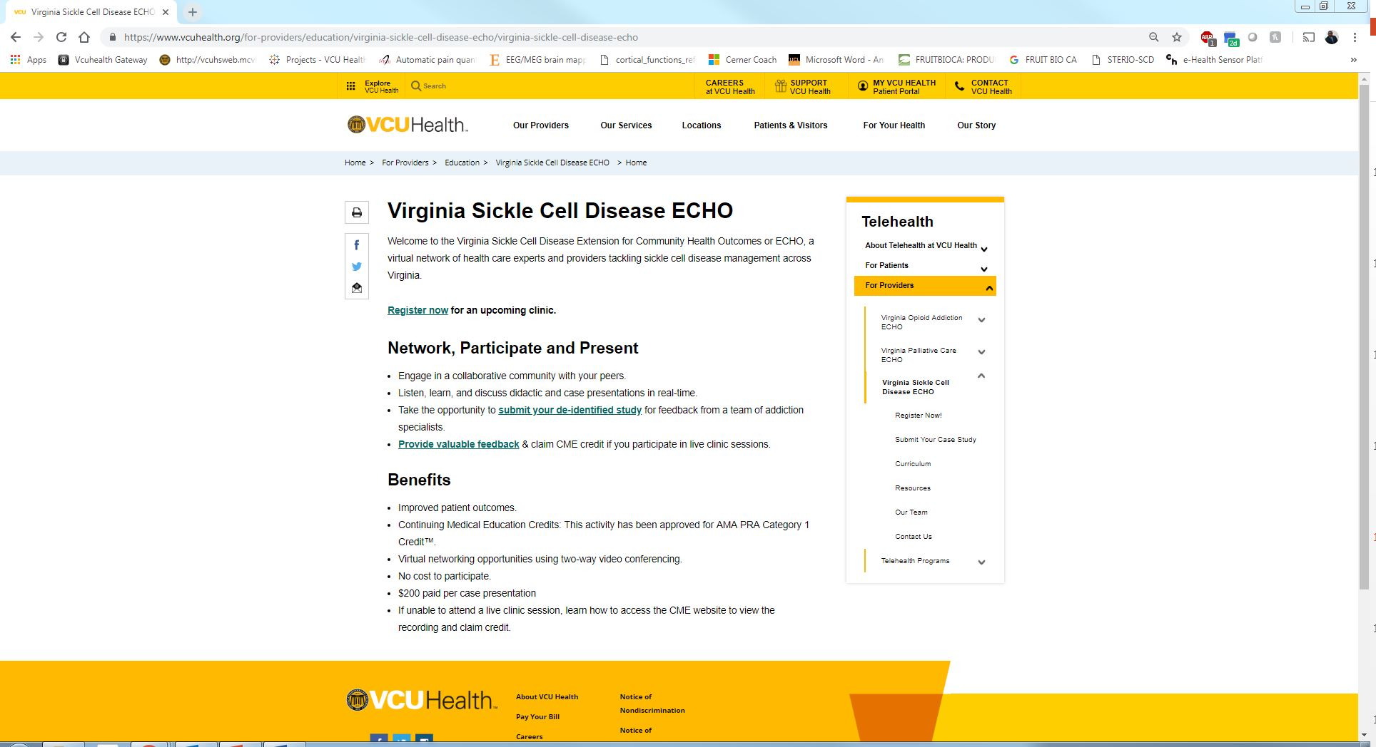
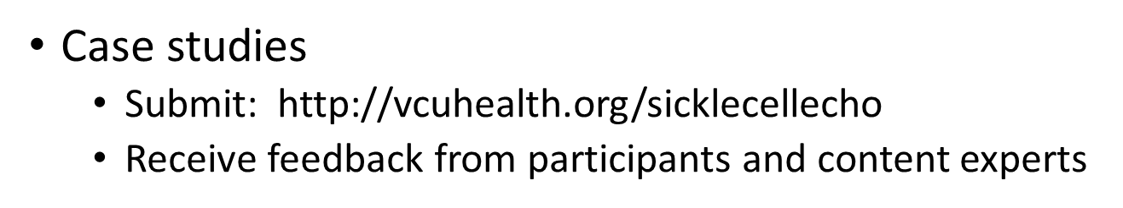
Case Studies

Slide 43
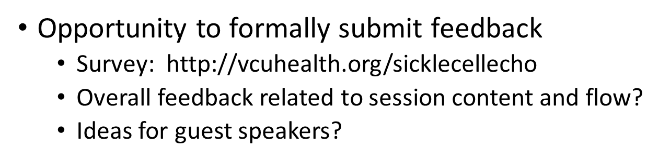
Feedback

Slide 44
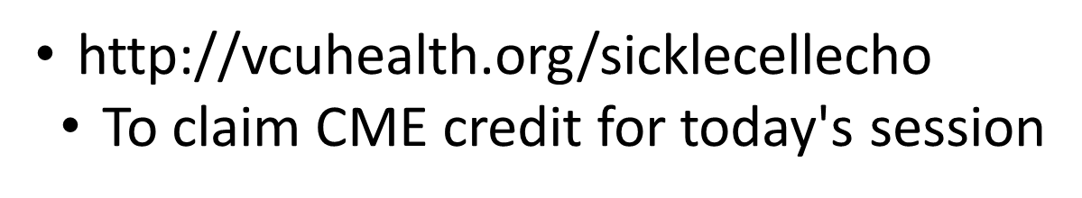
Claim Your CME’s

Slide 45
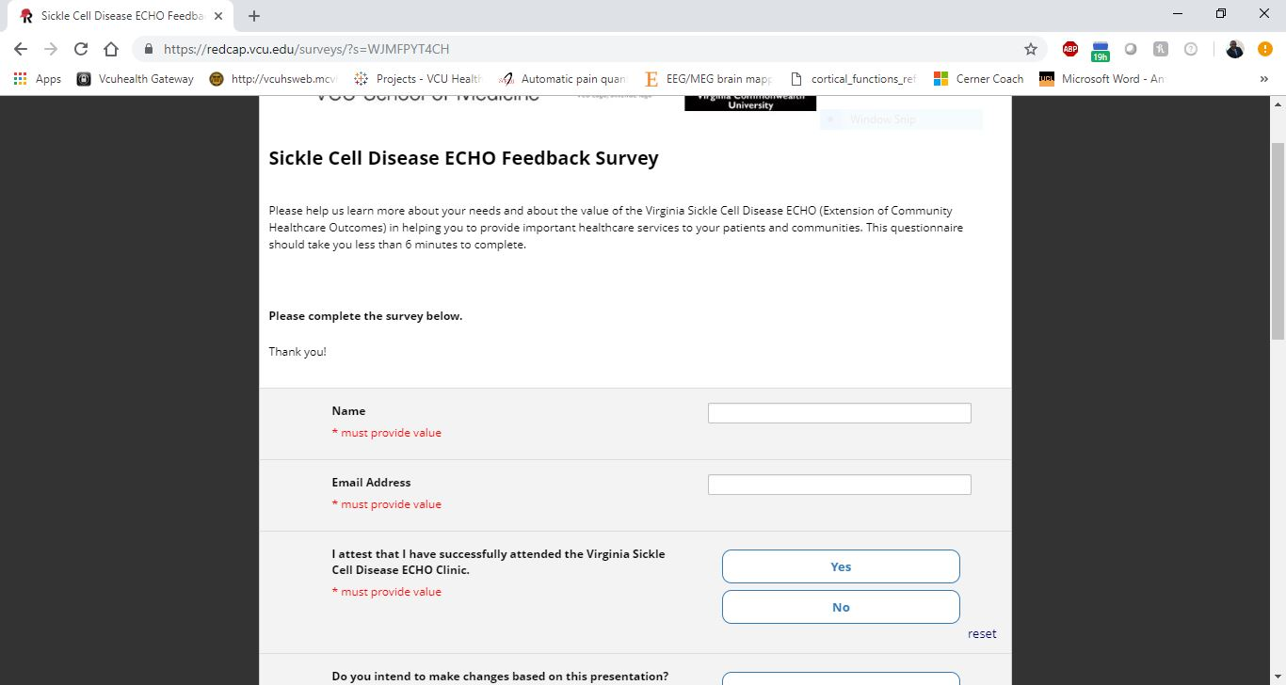
Access Your Evaluation and Claim Your CME

Slide 46
THANK YOU!

