Slide 1
Virginia Sickle Cell Disease ECHO* Clinic
April 10th, 2019
*ECHO: Extension of Community Healthcare Outcomes

Slide 2
Helpful Reminders
Rename
Rename your Zoom screen, with your name and organization

Slide 3
Helpful Reminders
You are all on mute
please unmute to talk
If joining by telephone audio only, *6 to mute and unmute
Unmute

Slide 4
Helpful Reminders
Please type your full name and organization into the chat box
Use the chat function to speak with IT or ask questions
Chat Box

Slide 5
VCU Sickle Cell Disease ECHO Clinics
Monthly 2 hours tele-ECHO Clinics
Every tele-ECHO clinic includes 2 case presentations and a didactic presentation
Didactic presentations are developed and delivered by inter-professional experts in Sickle Cell Disease care and management
Website Link: http://vcuhealth.org/sicklecellecho

Slide 6
Hub Introductions
VCU Team
Clinical Director | Wally R Smith, MD
Administrative Medical Director ECHO Hub and Principal Investigator | Wally R Smith, MD
Clinical Expert Didactic Presentation Program Manager IT Support Administrative Assistant Clinical Social Worker Patient Navigators Prior Authorization Specialist | India Y Sisler, MD Thokozeni Lipato, MD Jennifer Newlin, PA Mica Ferlis, NP Thokozeni Lipato, MD Shirley Johnson, LSW Daniel M Sop, M.Sc.Eng Donna Casey Taylor Elliott, MSW Marla Brannon, BSW Stefani Vaughan-Sams Austin Hardy

Slide 7
Spoke/ Participant Introduction
Name
Organization

Slide 8
What to Expect
Case presentation #1 – Elizabeth Yang, MD, PhD
Case summary
Clarifying questions
Recommendations
Recap
Didactic Presentation
Title: Safe Outpatient Management of Sickle Cell Disease Related Chronic Pain
Presenter: Thokozeni Lipato, MD
Case presentation #2 – Chelsea Rivenbark, NP
Case summary
Clarifying questions
Recommendations
Recap
Closing and questions
Lets get started!
Case Presentation #1

Slide 9
Case Presentation #1
12:50PM to 1:15pm [25 min]
Presentation: (5 min)
Case summary: Clinical Hub Lead(5 min)
Clarifying questions- Spokes (participants) 4 min:
Clarifying questions – Hub (4 min):
Recommendations – Spokes (participants) 2 min:
Recommendations – Hub (2 min):
Recap Case /Recommendations- Hub (3 min):

Slide 11
Didactic Presentation

Slide 12
Safe Outpatient Management of Sickle Cell Disease Related Chronic Pain
Thokozeni Lipato, MD
Assistant Professor, General Internal Medicine
Virginia Commonwealth University

Slide 13
Objectives
1. Identify best opioid misuse/abuse screening tools to use for the management of chronic Sickle Cell Disease (SCD) pain
2. Determine whether or not chronic opioid therapy (COT) is successful in the management of chronic SCD pain
3. Discuss what can be done for patients with chronic SCD pain who are not stable on COT

Slide 14
Assessment tools
Clear consensus
Prior to initiating opioids for chronic pain assess for the risk of opioid abuse
Reassess regularly for aberrant-drug related behavior after initiating chronic opioid therapy
No consensus on which assessment tool to use

Slide 16
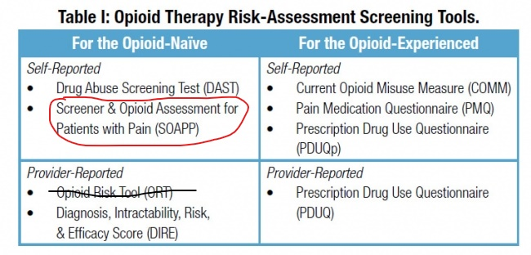
SOAPP-R
24 item tool
Can be used to distinguish between low, moderate and high-risk groups
A systemic review of validated risk measurement tools. British Journal of Anaesthesia, 119 (6): 1092–109 (2017)

Slide 17
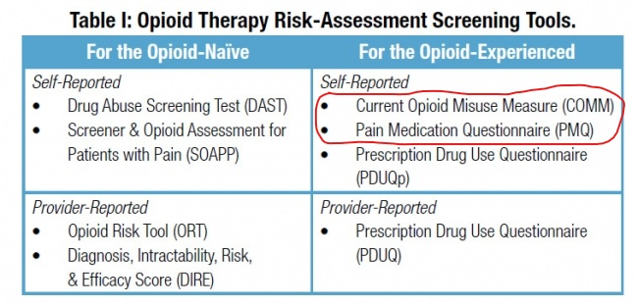
COMM
17-item tool
Best tool to screen for current misuse of opioids.
Use for regular monitoring
PMQ
26-item tool
Evaluates the risk of aberrant drug taking behavior
Can be used to distinguish between low and high-risk groups.
A systemic review of validated risk measurement tools. British Journal of Anaesthesia, 119 (6): 1092–109 (2017)

Slide 18
When is COT successful?
Intensity of Chronic Pain — The Wrong Metric? N Engl J Med 2015; 373:2098-2099
Assessing pain-related functional impairment (Pre- and post- intervention)
Treat to a pain level and functional goal

Slide 19
Assessing disease related impairment
PROMIS® (Patient-Reported Outcomes Measurement Information System)
Person-centered measurement system
Evaluates & monitors physical, mental, and social health.
General population & with individuals living with chronic conditions
ASCQ-Me® (Adult Sickle Cell Quality of Life Measurement Information System)
Patient-reported outcome measurement system
Evaluates & monitors the physical, mental, and social well-being of adults with sickle cell disease (SCD).

Slide 20
When is COT successful?
When it reduces emergency department visits & hospitalizations

Slide 21
Caring for the failing patient
Increase frequency of visits; shorten opioid prescription
Close monitoring of opioids (i.e. pill counts)
Increase frequency of UDS
Behavioral health intervention (SW; psychologist)
Patient navigators
Opioid reduction, or tapered withdrawal
Transition to safer pain regime (Tramadol; buprenorphine-naloxone)
ED & Inpatient pain management plans tailored by outpatient team

Slide 22
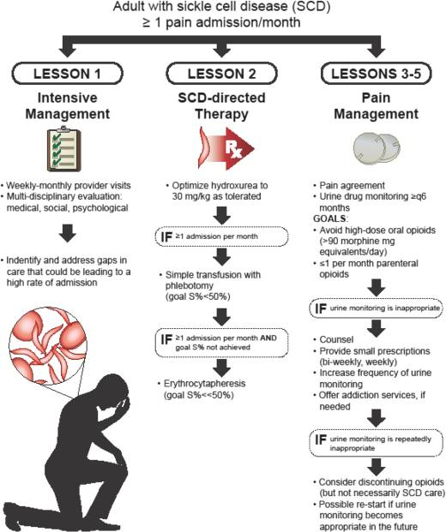
Field JJ. Five lessons learned about long-term pain management in adults with adults sickle cell disease. Hematology Am Soc Hematol Educ Program. 2017 Dec 8;2017(1):406-411
Focus resources on adults with high rates of utilization for pain
Aggressively treat any underlying causes of pain, including SCD
Apply principles of chronic pain management to a clinic model
Higher doses and larger quantities of oral opioids often do not help
Parenteral opioids are not the optimal treatment of chronic pain

Slide 23
Substance misuse treatment for high-risk chronic pain patients on opioid therapy: A randomized trial
PAIN 150 (2010) 390–400

Slide 24
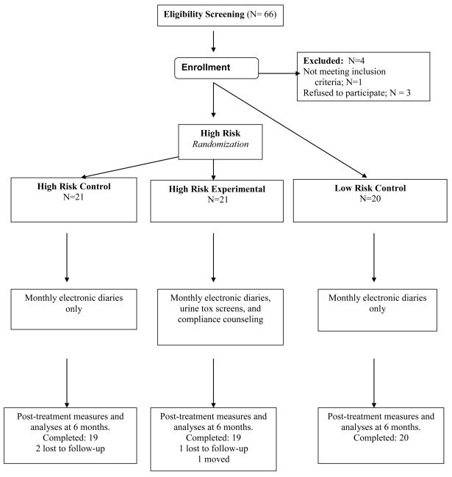

Slide 25
High-risk experimental group
Completion of monthly electronic diaries
Monthly urine screens for 6 months
Monthly completion of the Opioid Compliance Checklist
Monthly group education sessions (led by a psychiatrist [ADW] trained in pain and addiction medicine) with worksheet handouts on topics related to substance misuse
Participation in individual motivational compliance counseling (led by a clinical psychologist [RNJ] trained in pain and behavioral medicine) offering knowledge and training for substance misuse awareness and recovery

Slide 26
Taken your opioid medication other than the way it was prescribed?
Used more than one pharmacy to fill your opioid prescriptions?
Received opioid prescriptions from more than one provider?
Lost or misplaced your opioid medications?
Run out of your pain medication early?
Missed any scheduled medical appointments
Borrowed opioid medication from others?
Used any illegal or unauthorized substances?
Taken the highest possible degree of care of your prescription medication?
Taken any unauthorized substance that might be found in your urine
Been involved in any activity that may be dangerous to you or someone else if you felt drowsy or were not clear thinking?
Been completely honest about your personal drug use?
Opioid Compliance Checklist

Slide 28
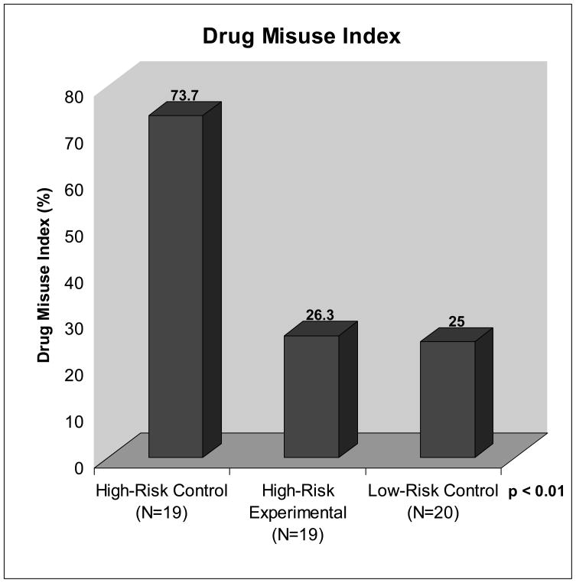

Slide 29
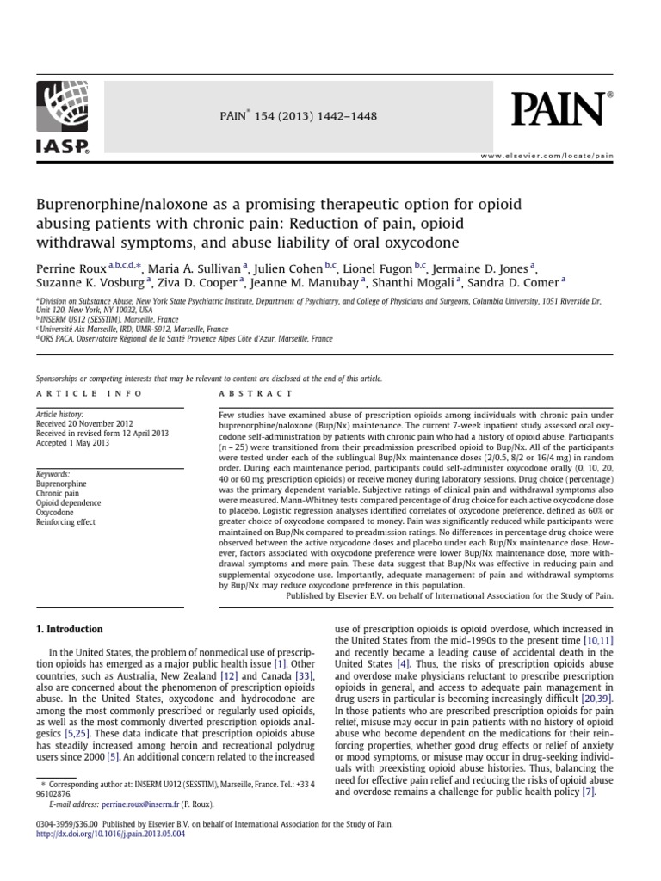
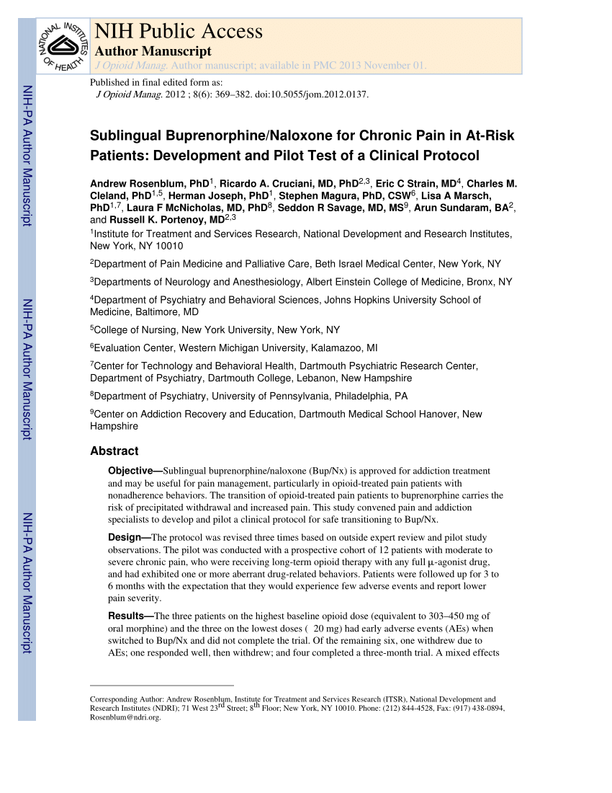
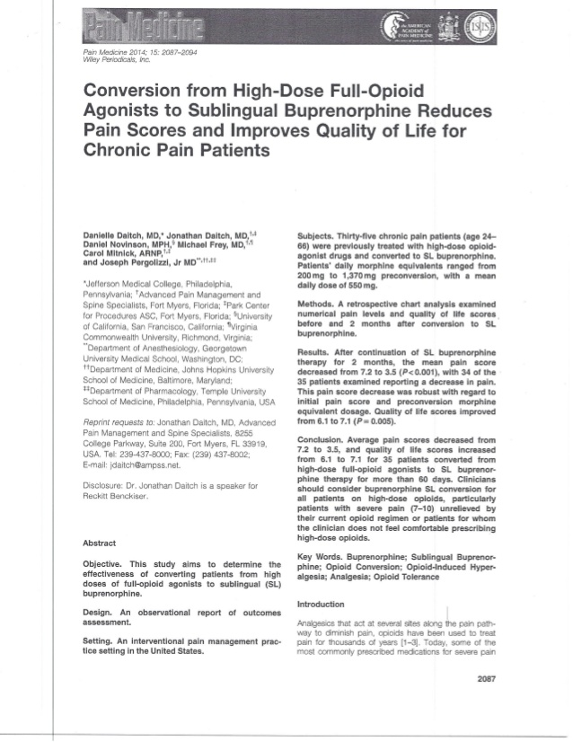

Slide 30
Case Presentation #2
1:40- 2:00pm [25 min]
Presentation: (5 min)
Case summary: Clinical Hub Lead(5 min)
Clarifying questions- Spokes (participants) 4 min:
Clarifying questions – Hub (4 min):
Recommendations – Spokes (participants) 2 min:
Recommendations – Hub (2 min):
Recap Case /Recommendations- Hub (3 min):

Slide 32
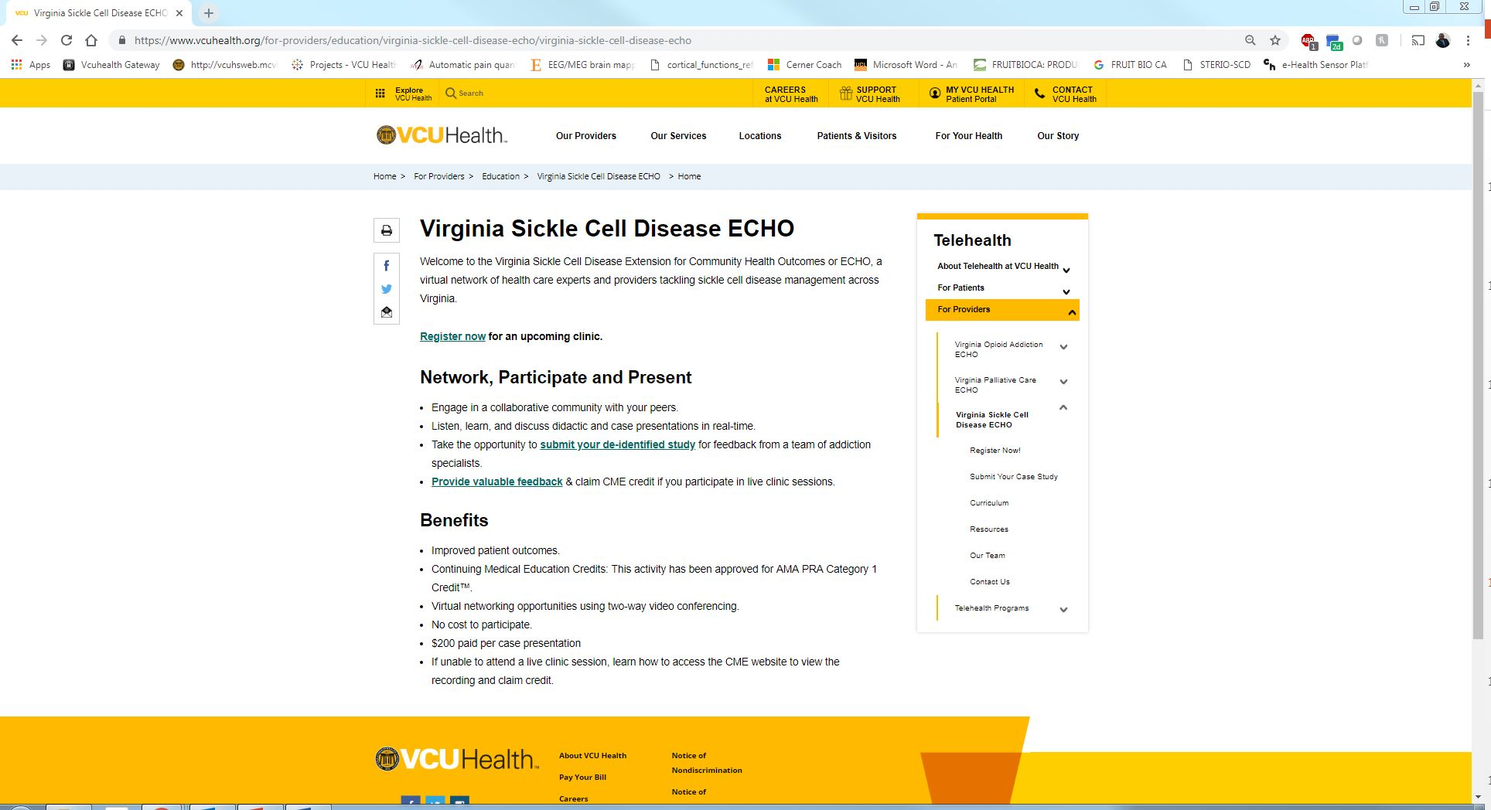
Case Studies

Slide 33
Feedback

Slide 34
Claim Your CME’s

Slide 35
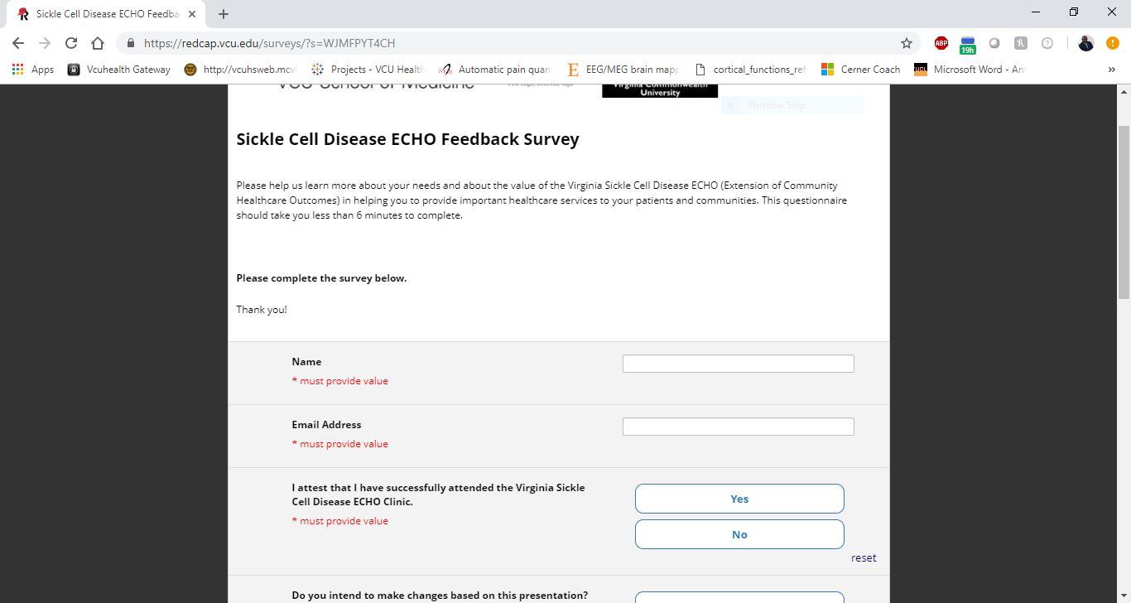
Access Your Evaluation and Claim Your CME

Slide 36
THANK YOU!

